Slide 1
Introduction to Computing for Data Analysis
Pairwise association mining
Richard Vuduc, Ph.D.
Associate Professor
School of Computational Science and Engineering
Algorithm summary

Slide 2







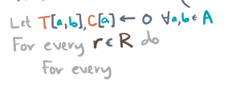

Slide 3


Slide 5


Slide 6
Summary so far
Data: Receipts
Analysis: Frequently co-occurrences
Formalization: Compute conf(a ⇒ b)
Algorithm: Visit and tabulate itemsets

